Slide 1

Exquisite Corpse
A Surrealist Drawing Game

Slide 2
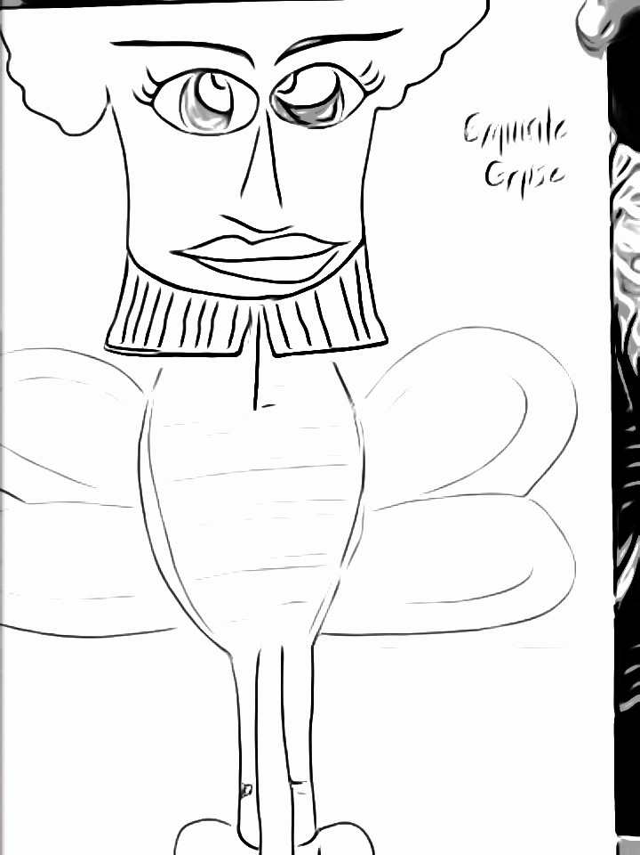
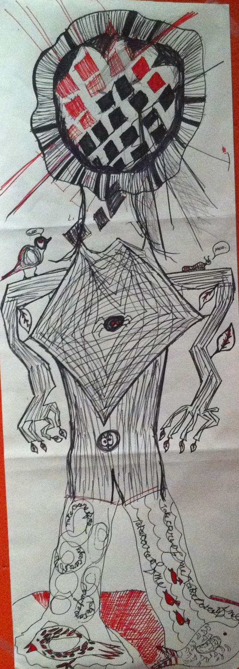
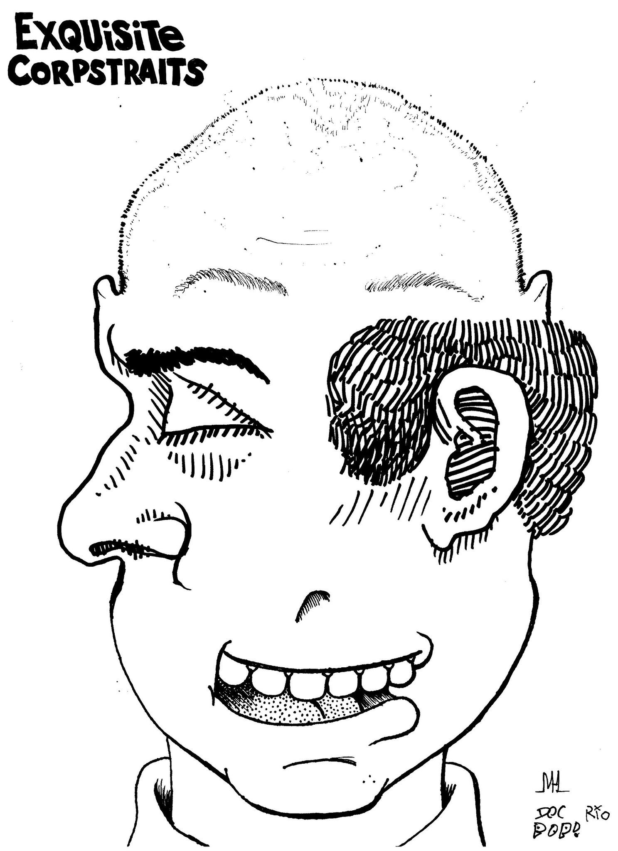

Slide 3
Exquisite Corpse Instructions
Groupings: Divide into groups of three. Groups can be of varying drawing abilities.
Preparation: Get a blank piece of paper and a pencil or pen. Fold the paper into thirds: the upper third will be used for the head to the shoulders, the middle third will be for the torso, and the lower third will depict the hips to the feet.
Head to Shoulders: Draw a head on the upper third of the paper then fold the paper, leaving small marks on the top of the middle third that would indicate to the next student to continue from the marks, connecting the head to the torso.
Pass the folded paper to the next student.
Torso: Now draw the torso, leaving small marks on the third portion of the page to indicate where the next student will continue from the marks, connecting the torso to the hips and feet.
Pass the folded paper to the next student.
Hips to Feet: Lastly, draw the hips to feet on the bottom third of the figure. Open the page to see how chance functioned in the creation of art and how groups in the class “improvised” and together were able to create interesting and imaginative art.

Slide 4
cquarts. Exquisite Corpse. 4 November 2012. Retrieved from https://flic.kr/p/dqNMCB
Doctor Polar. Exquisite Caricature 02. 30 April 2007. Retrieved from https://flic.kr/p/JeA7E
The Center for Intuitive and Outsider Arts. Exquisite Corpse Drawing Social. 20 October 2012. Retrieved from https://flic.kr/p/dne7aJ

